Slide 1

SQL Presentation
By K.Tejus

Slide 2





What is SQL?

Slide 3

A Database is a structured collection of data, organized for efficient storage and retrieval.
SQL stands for Structured Query Language is a language for managing databases.
We use it for operations like retrieving, inserting, updating, and deleting data.

Slide 4


SQL works with structured data in tables in the form of rows and columns.
It provides a standardized way to work with databases.
SQL is used in various industries and applications.
It helps you interact with and manipulate data efficiently.

Slide 5
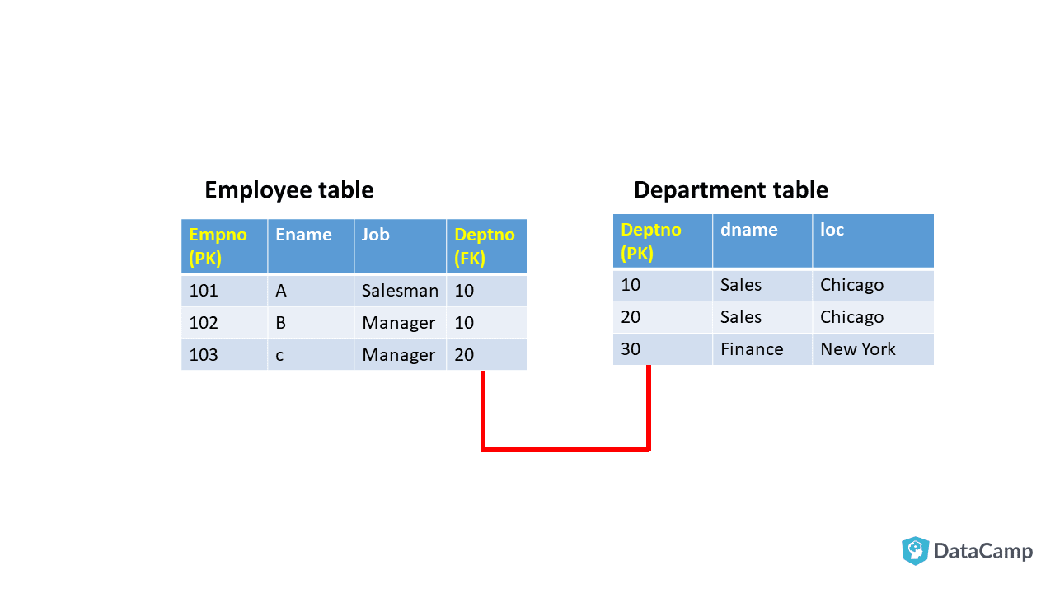
Example

Slide 6
MASTER DATA
TRANSACTIONAL DATA
Master data includes essential information like customers, products, and employees.
It's stable, changes infrequently, and acts as a foundation for business processes.
Master data is integrated, maintained centrally, and ensures data consistency.
Transactional data captures specific business activities like sales, purchases, and interactions.
It's dynamic, changing in real-time, and provides operational insights.
Transactional data is high in volume.

Slide 7
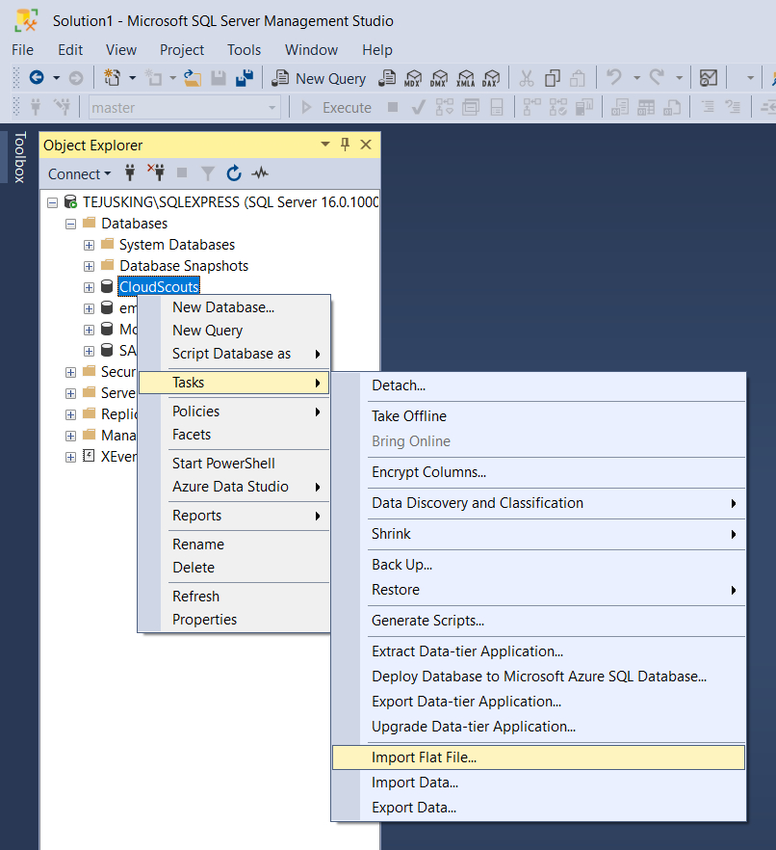
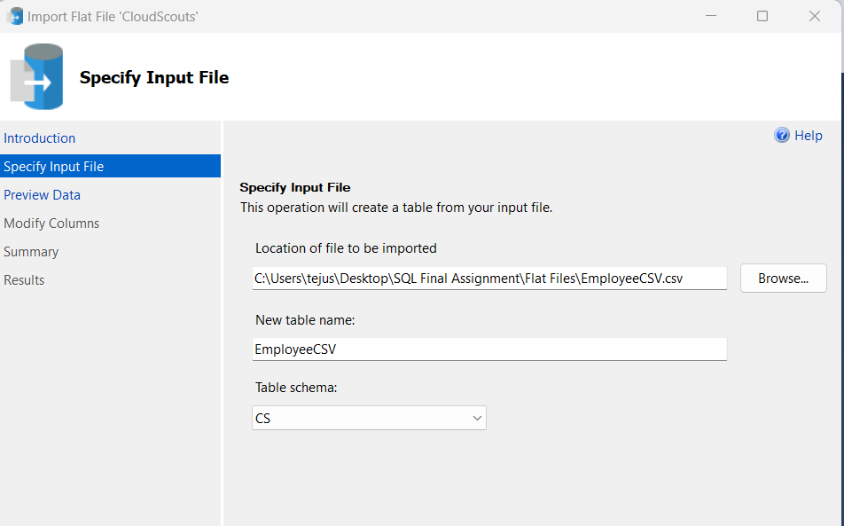
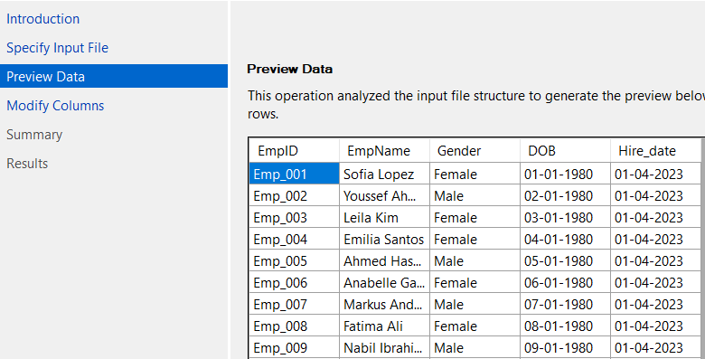
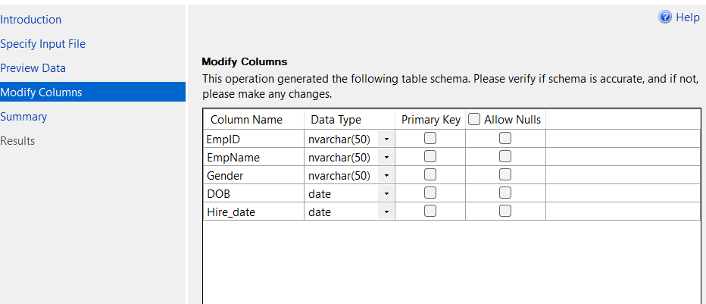
Query 1: Create Four Tables: Employee, Position, Location and Salary Information under a Database called Employee Management and upload each of these CSVs.
Step-1
Step-2
Step-3
Step-4

Slide 8
Query 1: Create Four Tables: Employee, Position, Location and Salary Information under a Database called Employee Management and upload each of these CSVs.

Slide 9
Query 1: Create Four Tables: Employee, Position, Location and Salary Information under a Database called Employee Management and upload each of these CSVs.

Slide 10
Query 1: Create Four Tables: Employee, Position, Location and Salary Information under a Database called Employee Management and upload each of these CSVs.

Slide 11
Query 1: Create Four Tables: Employee, Position, Location and Salary Information under a Database called Employee Management and upload each of these CSVs.

Slide 12
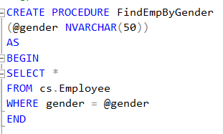
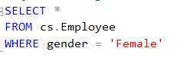
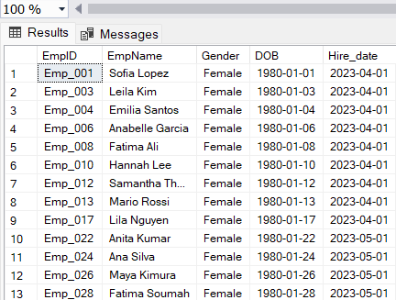
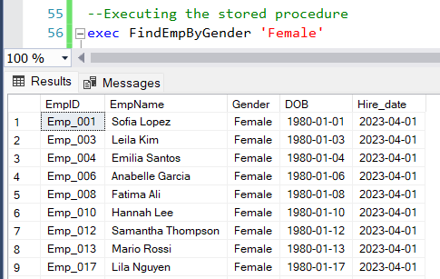
Query 2: Fetch the count of female employees from the company.
Query:
Query:
Result:
Result:

Slide 13
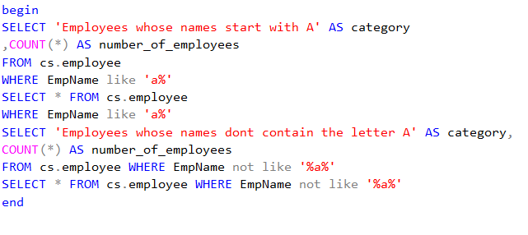
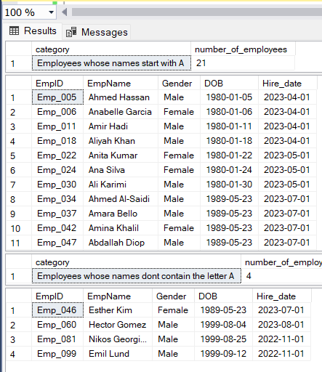
Query 3: Fetch employee details whose name starts with A and whose name does not contain character 'a'.

Slide 14
Query 3: Fetch employee details whose name starts with A and whose name does not contain character 'a'.
Query

Slide 15
Query 3: Fetch employee details whose name starts with A and whose name does not contain character 'a'.
<-Result

Slide 16
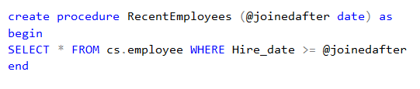
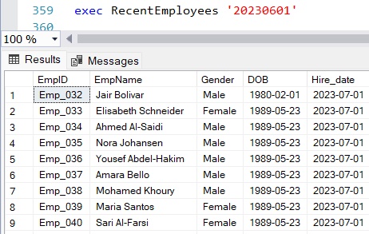
Query 4: Retrieve the list of employees who joined the company recently.
Query:
Result:

Slide 17
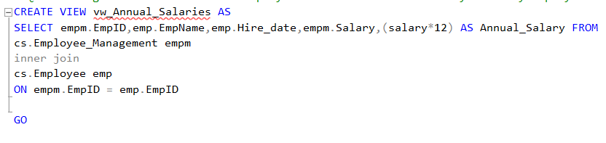
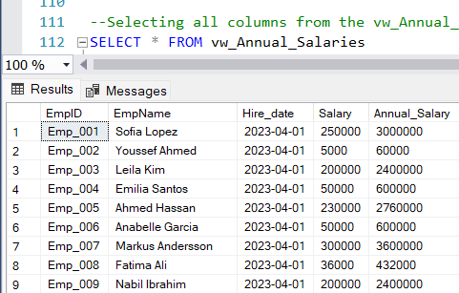
Query 5: Create a view showing the annual salary of every employee (Name it vw_Annual_Salaries).
Query:
Result:

Slide 18
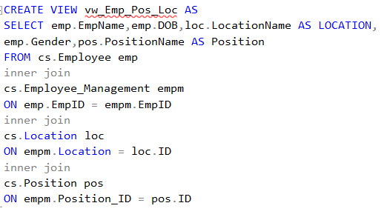
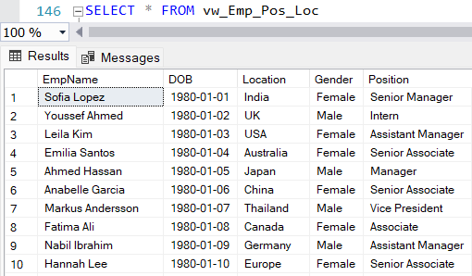
Query 6: Create a view to show employee name, date of birth, location, gender and position (Show only names not the ids . Use joins concept)
Query:
Result:

Slide 19
Query 6: Create a view to show employee name, date of birth, location, gender and position (Show only names not the ids . Use joins concept)
Query:
Result:

Slide 20
Query 6: Create a view to show employee name, date of birth, location, gender and position (Show only names not the ids . Use joins concept)
Query:
Result:

Slide 21
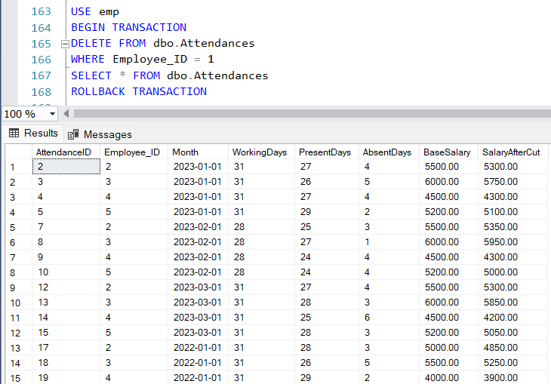
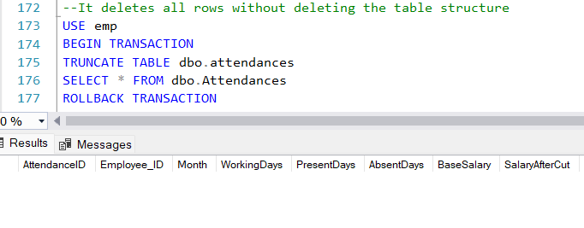
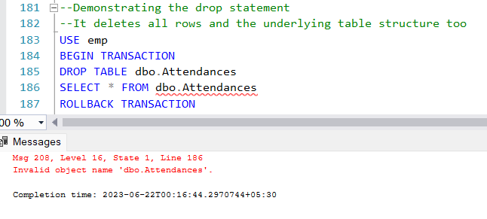
Query 7: Demonstrate the difference between delete, truncate and drop using your any of the existing tables.
Delete
Truncate
Drop

Slide 22
Query 7: Demonstrate the difference between delete, truncate and drop using your any of the existing tables.
Truncate
Drop
Delete

Slide 23
Query 7: Demonstrate the difference between delete, truncate and drop using your any of the existing tables.
Drop
Delete
Truncate

Slide 24
Query 7: Demonstrate the difference between delete, truncate and drop using your any of the existing tables.
Delete
Truncate
Drop

Slide 25
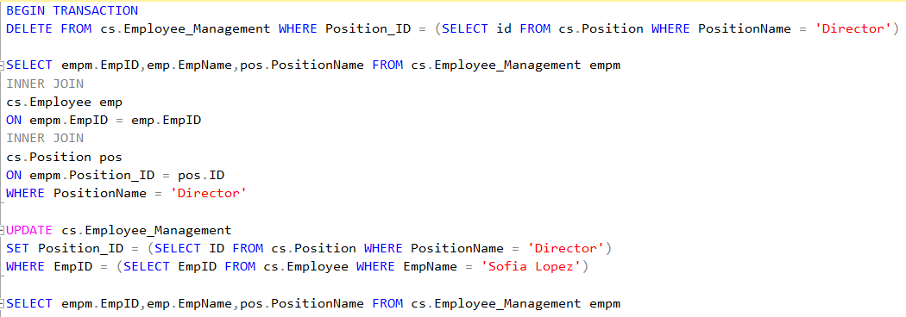
Query 8: Promote employee "Sofia Lopez" to Director, terminate the existing Director and also promote "Leila Kim" to Senior Manager
Query:

Slide 26
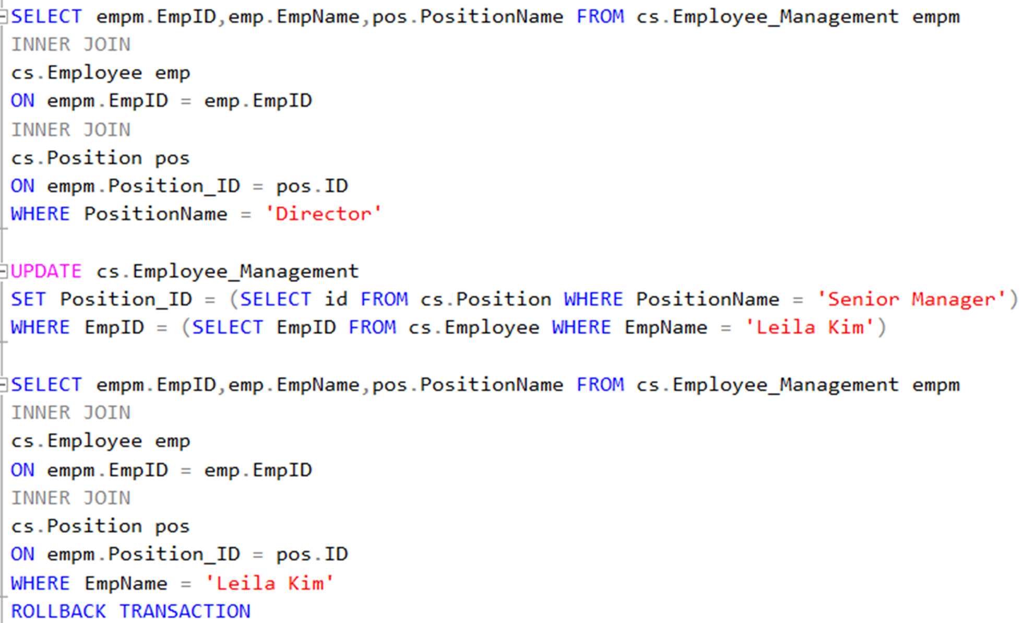
Query 8: Promote employee "Sofia Lopez" to Director, terminate the existing Director and also promote "Leila Kim" to Senior Manager
Query:

Slide 27
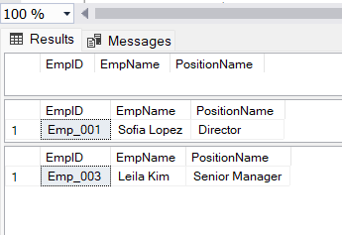
Query 8: Promote employee "Sofia Lopez" to Director, terminate the existing Director and also promote "Leila Kim" to Senior Manager
Result:

Slide 28
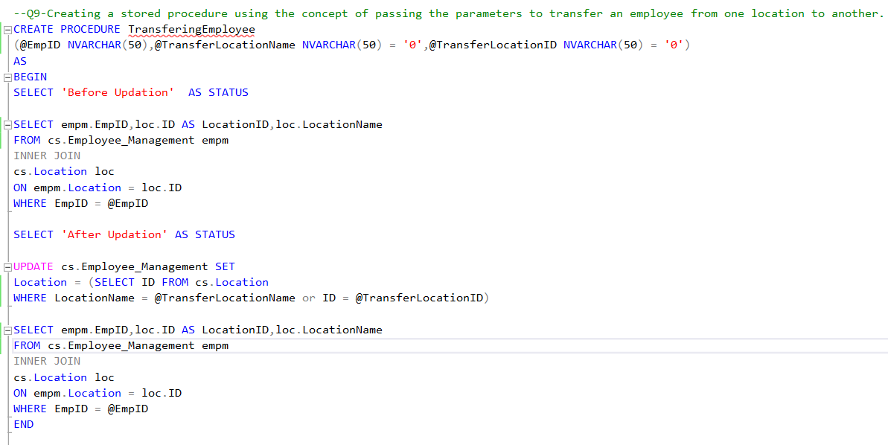
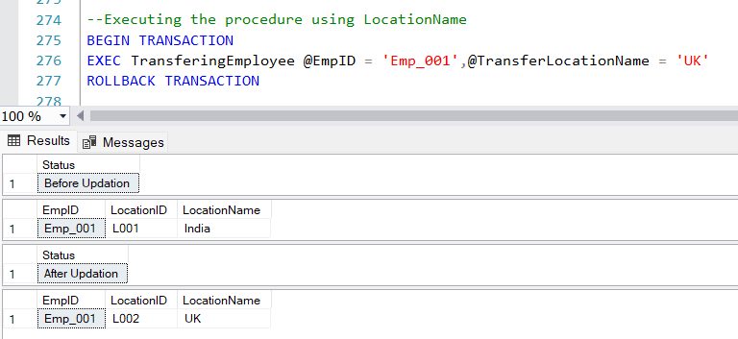
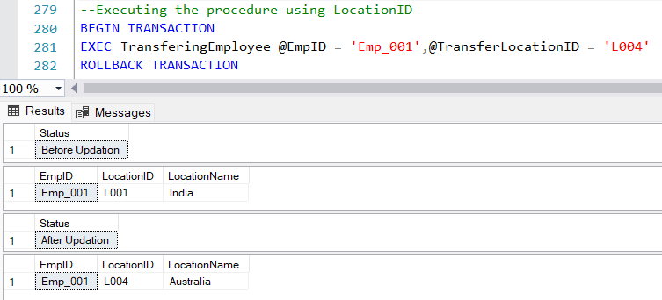
Query 9: Create a stored procedure using the concept of passing the parameters to transfer an employee from one location to another.
Query:
Result:

Slide 29
Query 9: Create a stored procedure using the concept of passing the parameters to transfer an employee from one location to another.
Query:
Result:

Slide 30
Query 9: Create a stored procedure using the concept of passing the parameters to transfer an employee from one location to another.
Result:

Slide 31
Query 9: Create a stored procedure using the concept of passing the parameters to transfer an employee from one location to another.
Result:

Slide 32
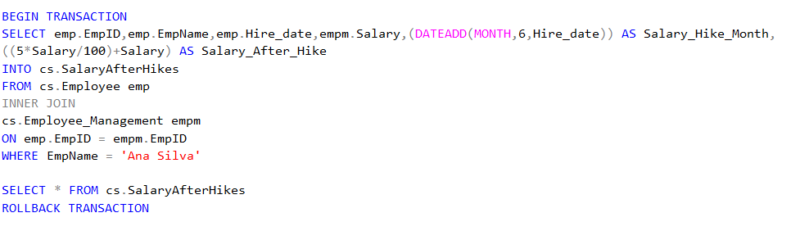
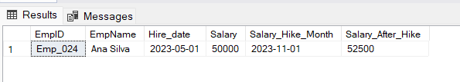
Query 10 : Write a Query to display the current salary of the employee "Ana Silva" and based on Hire Date give 5% increment after six months and insert this data into new table without effecting any of the existing tables.
Query:
Result:

Slide 33
Query 10 : Write a Query to display the current salary of the employee "Ana Silva" and based on Hire Date give 5% increment after six months and insert this data into new table without effecting any of the existing tables.
Query:

Slide 34
Query 10 : Write a Query to display the current salary of the employee "Ana Silva" and based on Hire Date give 5% increment after six months and insert this data into new table without effecting any of the existing tables.
Result:

Slide 35







THANK YOU

